Slide 1
The tax efficient legacy
Insurance products provided by Fortress Brokerage Solutions
Notes:
Life insurance is a versatile financial tool. In addition to the death benefit, other aspects of life insurance can serve many of your clients financial needs.
Provided they are not modified endowment contracts, policy values grow without the burden of taxes. When properly accessed through loans and withdrawals, distributions can be tax-advantaged as well.
Welcome to another installment of Life Insurance as a Financial Tool. You’ve all probably learned by now how to lower your clients’ effective tax rate in retirement using distributions from their life insurance policy.
We’ve also showed you how to help your younger clients who need life insurance how to get in the game earlier, and fund a policy well enough to pre-pay their retirement taxes.
In this presentation, we will talk about a long-followed strategy of policyholders using retirement asset distributions to fund a life insurance policy in order to maximize the wealth they transfer to their heirs. Some call it, “IRA max.” We like to call it something your client will better identify with, “The Tax Efficient Legacy.”

Slide 2
Decisions for retirement dollars
Pre-pay retirement taxes
Anticipates the need to pay the taxes that will be due on retirement asset distributions during retirement
Funds a life insurance policy; solving for distributions in retirement equal to the tax on retirement asset distributions
Tax efficient legacy
Does not need required minimum distributions for retirement
Wants to pass a tax efficient legacy to their heirs.
Uses those distributions to fund a life insurance policy to pass on to heirs
Pre-pay beneficiary taxes
Assumes no need for qualified plan dollars in retirement
Intention is to bequeath those assets to heirs
Funds a life insurance policy; solving for the amount of taxes owed on the entire inherited IRA
Notes:
[read slide in addition to speakers notes]
Your clients may find themselves at any number of forks in the road as they make final preparations for retirement. If they’ve followed the LIFT strategy, they will look forward to lowering their effective tax rates in retirement by using their life insurance policy to supplement their retirement.
Perhaps they started earlier in life, and focused funding of their life insurance in order to have the dollars on hand to pay the tax on their retirement asset distribution. In effect, they were pre-paying their retirement taxes, while protecting their family if they died.
But what if they’re in a position where they realize they won’t need their retirement plan money? They can create a tax efficient legacy for their children and/or grandchildren by using those dollars to further fund their life insurance.
<Presenters: the Pre-pay beneficiary taxes is currently in development with an indeterminate finish date. Feel free to mention it, but only to the detail noted on-screen. Refer anyone with additional questions or feedback on this concept should contact the advanced sales team>

Slide 3
LIFT – Life insurance as a financial tool
Help your clients protect their families during their working years
Become a source of supplemental retirement income
Transfer their financial legacy to their family
Notes:
Whether your clients are in the accumulation, retirement or estate maximization phase of life, the right mix of financial tools can help minimize their taxes and maximize their assets. With Life Insurance as a Financial Tool (LIFT), you can illustrate why a successful financial strategy includes many tools — including permanent life insurance.
No tool can solve every problem. Our comprehensive “Life Insurance as a Financial Tool” or “LIFT” campaign, positions you to show clients why they should consider a variety of tools for their retirement strategy.
One of these financial tools is permanent, cash value life insurance. LIFT helps you demonstrate how life insurance is a key financial tool that can:
Help your clients protect their families and assets during their working years.
Become a source of supplemental funds during retirement that can help clients:
Transfer their financial legacy to their family

Slide 4
Help your client create a tax efficient legacy
Qualified plans are a good way to accumulate money for retirement — but not so efficient for transferring that wealth.
Notes:
Qualified plans are a good way to accumulate money for retirement — but not so efficient for transferring that wealth.
If your clients don’t need the money, why not use those required distributions to fund a life insurance policy — and create a tax-efficient legacy for their loved ones?

Slide 5
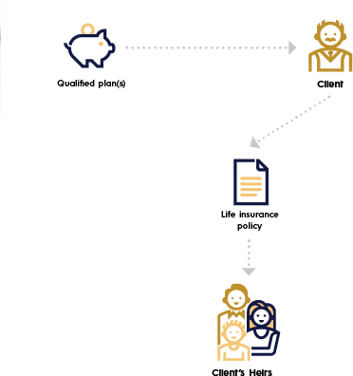
Leaving a tax efficient legacy
Opportunity
Clients spend years building their retirement
In retirement, realize they don’t need the distributions
Have a life insurance need*
Have multiple sources of income and assets with varying tax implications
Children are in a higher tax bracket
*If owner and insured are different, the death benefit will be paid upon death of the insured.
Notes:
Your clients have spent years building up their retirement funds. Their goal was to accumulate these assets as tax-efficiently as possible, perhaps with qualified plans like 401(k)s.
Now, as they near or are in retirement, they realize they don’t need the money, and they’d like these assets to provide a legacy to their children or grandchildren. While tax-efficient for retirement savings, qualified plans are not so efficient for passing to the next generation.
Solution: Create a tax-efficient legacy
If they don’t need the money, they can use the required distributions of their qualified plan to fund a life insurance policy. This can create a more tax-efficient legacy for their heirs — and can make good sense, especially if any of these situations apply:
They need a life insurance death benefit to pay estate taxes when they* die
Their children are in a higher tax bracket than they are
They have multiple sources of income and assets with varying tax implications
They don’t need all of their qualified plan assets for living expenses
*If owner and insured are different, the death benefit will be paid upon death of the insured.

Slide 6
Target clients
Clients near or over age 59 ½
Anticipate no need for their retirement plan distributions, and would like to pass these assets as efficiently as possible to their children and grandchildren
Ability or desire to spend down their entire retirement asset to fund a more tax-efficient to pass
Notes:
Read slide

Slide 7

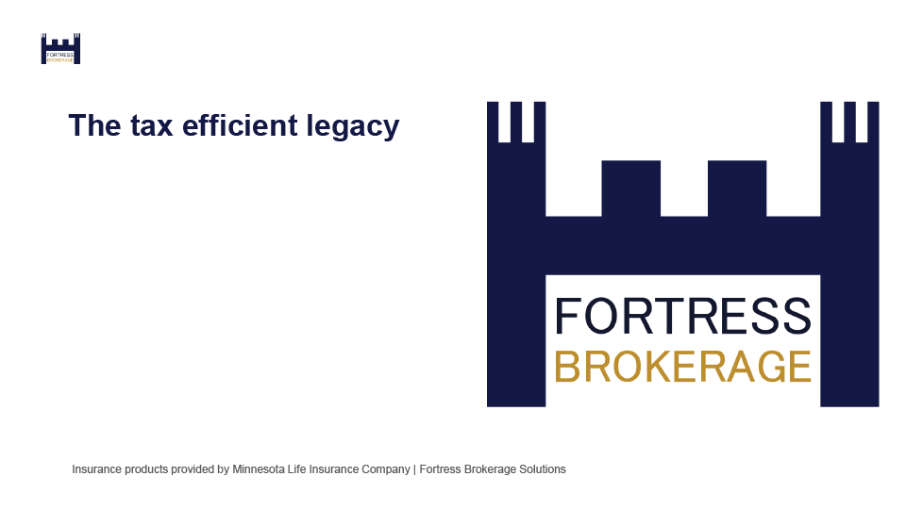
Tax efficient legacy marketing materials
Consumer brochure – F74093-54
Consumer PowerPoint
Illustration presentation
Notes:
We’ve developed a few marketing materials to help pitch this concept to clients.
First is a client brochure called Tax Efficient Legacy. Form number F74093-54; available now.
If you’re working with clients primarily through remote meetings and webinars, we’ve created a client-facing PowerPoint of the exact same content. It’s essentially a PowerPoint recreation of the brochure itself. All copy is the same and presented on-screen.
We also just launched an illustration sales presentation that can help you land the concept with clients with numbers specific to their situation. It uses the brochure as the front-end content for this illustration, then demonstrates the results of a set of assumptions on the client’s qualified plan, a generic investment and a life insurance policy.

Slide 8
How it works
Tax efficient legacy https://www.fortressbrokerage.com/
Notes:
In order to show your client this concept, we can use our tax efficient legacy illustration presentation, available in our illustration system on your professional web site.
Fortress Brokerage Solutions
Go to the on-screen link and log in…

Slide 9
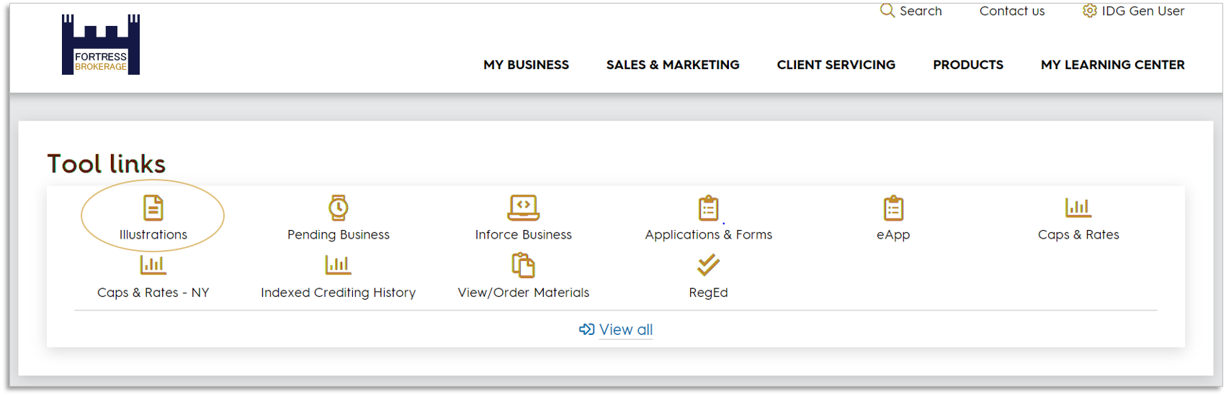
Go to our illustration system
Notes:
…and you’ll find our illustration system near the top of the page, shown circled here in the “Tool links” section.
<note to presenter: the location of this link on the page may differ depending on distribution channel. This view shows IDG general user.>

Slide 10
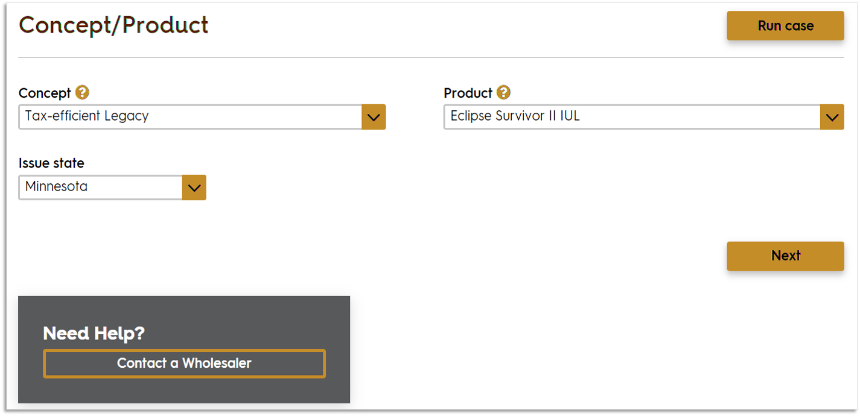
This is a hypothetical example for illustrative purposes only. Product features and availability may vary by state.
Notes:
Case ID 17536088
I’ll show you some screen grabs of the inputs for this strategy, but as it shows in the lower left here, if you get hung up just contact us.
This strategy works best with a survivorship product, so for this example we’ll use Eclipse Survivor II Indexed UL.

Slide 11
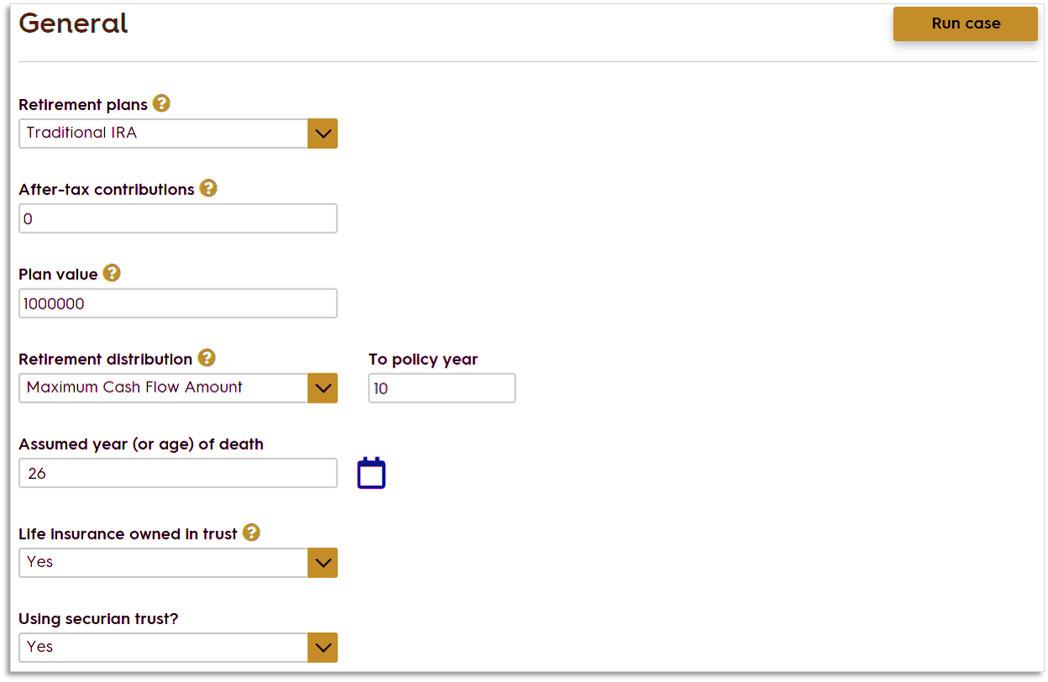
This is a hypothetical example for illustrative purposes only.
Notes:
On the general concepts tab is where we will start modeling the client’s qualified plan or other. We’re showing Traditional IRA here, but we can also select a 401(k), a SIMPLE IRA or a SEP IRA.
We’re showing distributions from the IRA for 10 years. This is the length of time over which the client will liquidate the retirement plan account. In general, the longer the distribution, the less annual income taxation the client will have; the shorter the distribution, the greater the death benefit the client can purchase. Suggested timeframe is 7 to 10 years (although age and tax situation may impact this.)
We’re also selecting the life insurance to be owned in a trust. By owning life insurance in a trust outside of the client’s estate, it may be protected from Federal estate taxation and/or aid in payment of taxes due.

Slide 12
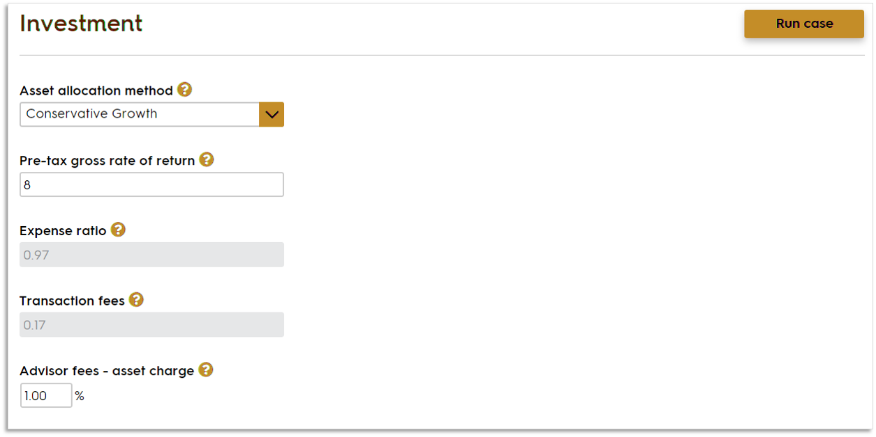
This is a hypothetical example for illustrative purposes only.
Notes:
[On the investment tab we’ll model a hypothetical investment with a conservative growth allocation method, and setting an 8 percent pre-tax rate of return. The expense ratio and transaction fees change with the allocation method. We’re also inputting a 1 percent asset charge.]

Slide 13
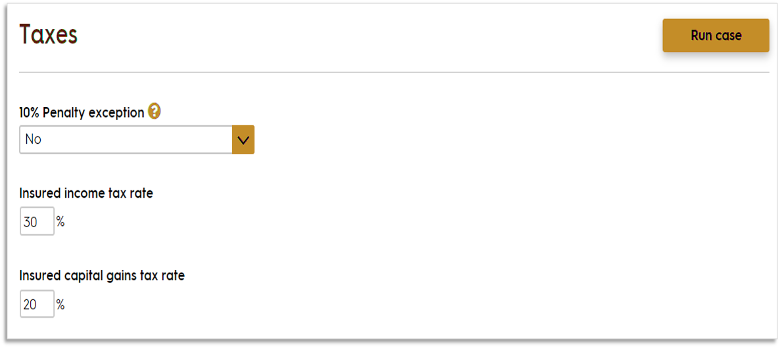
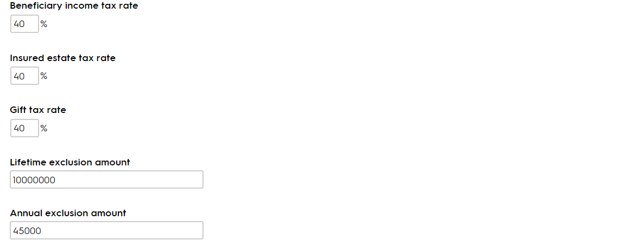
This is a hypothetical example for illustrative purposes only.
Notes:
[We set the tax rates on this tab <read through inputs>]

Slide 14
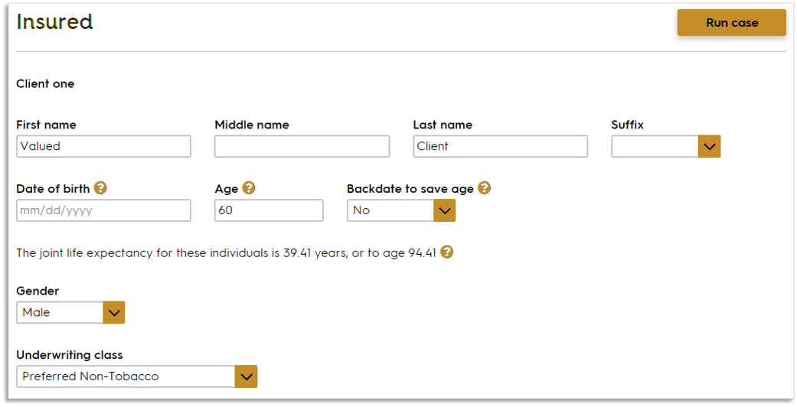
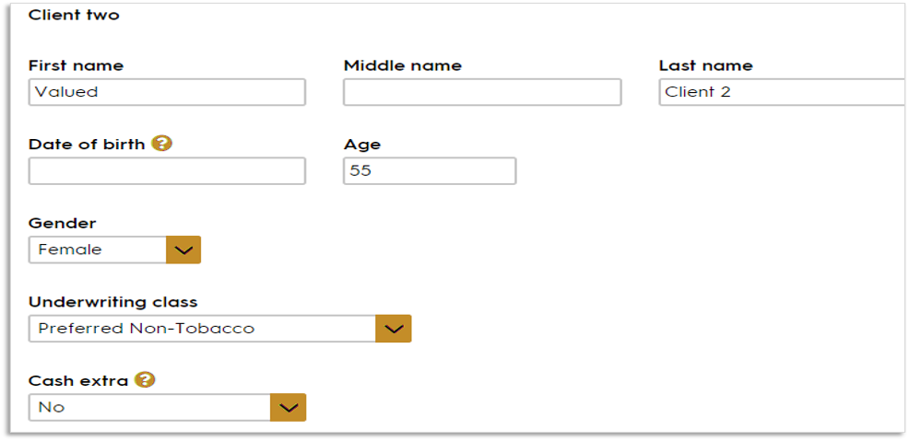
This is a hypothetical example for illustrative purposes only.
Notes:
[Read through inputs on slide]

Slide 15
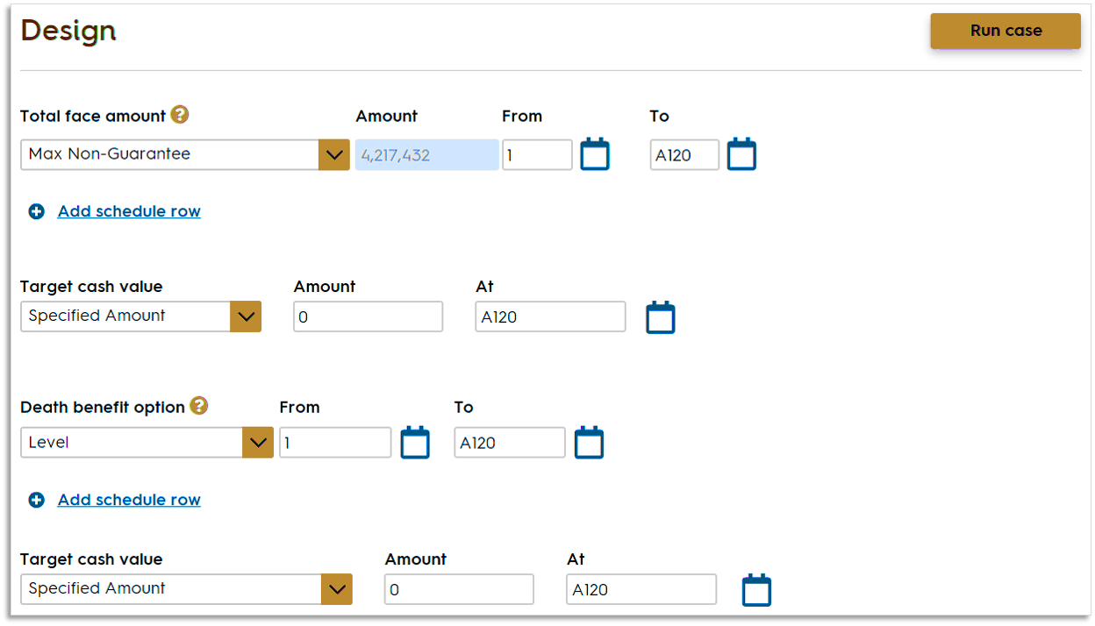
This is a hypothetical example for illustrative purposes only.
Notes:
[The only input we’re selecting on this tab is Max Non-guarantee for the total face amount. This will solve for the maximum face amount that will keep the contract in force for the requested length of time based on the premium paid.
Other options for this field are:
Specify Amount: Allows user to enter total face amount desired including Term Insurance Agreement, if applicable.
GSP Face: Allows user to enter a first year premium amount and solve for the minimum face allowed under GPT definition of life insurance for that premium.
Minimum Face: Solves for the minimum face amount that allows the requested planned premium and still qualify as life insurance.
Target Face: Solves for the face amount using the specified premium. Premium entered by user is defined as the "target premium" (i.e. maximum commissionable premium).
There are several other tabs of information we won’t go into here today. They are Distributions, which we’re not illustrating, Riders, Assumptions, where you will pick the crediting rate, and a tab for producer information.
Let’s go on to the output.]

Slide 16
The output
Notes:
After entering the rest of the information and running the case, we get a report. As I noted earlier, this presentation is built with the content of the consumer brochure serving as the front-end content for this report. This is to help ensure a continuity of message, imagery, and familiarity should you use the brochure to pitch this concept to your client in the first place.
Then this report gets a little robust…

Slide 17
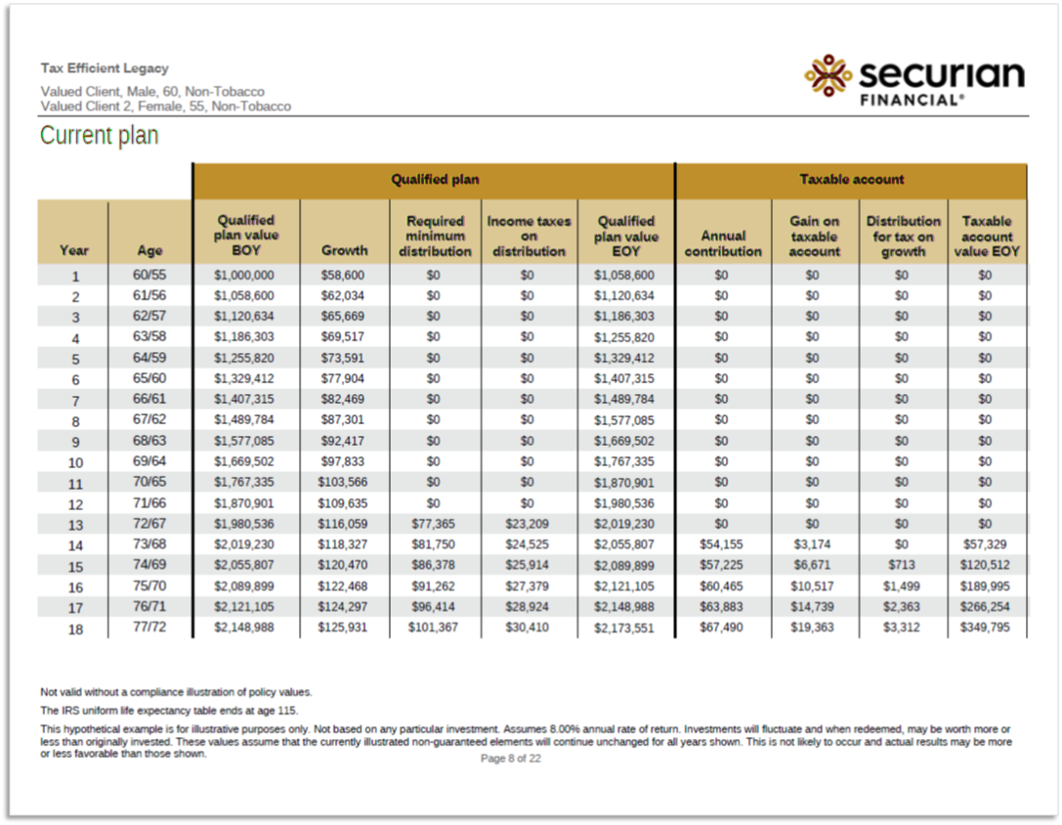
This is a hypothetical example for illustrative purposes only.
Notes:
Page [8] shows the modeling of the current plan.
<reiterate key aspects of this slide>

Slide 18
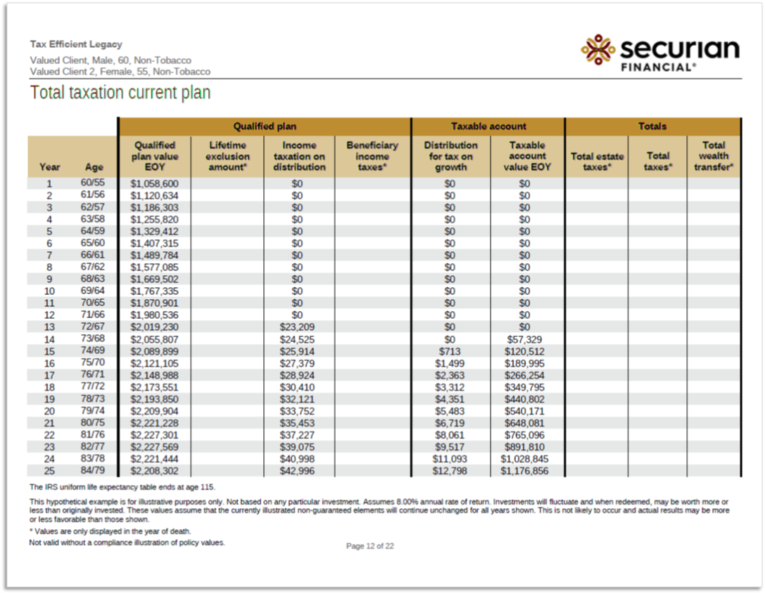
This is a hypothetical example for illustrative purposes only.
Notes:
Then beginning on page [12] we show the taxation of the current plan.

Slide 19
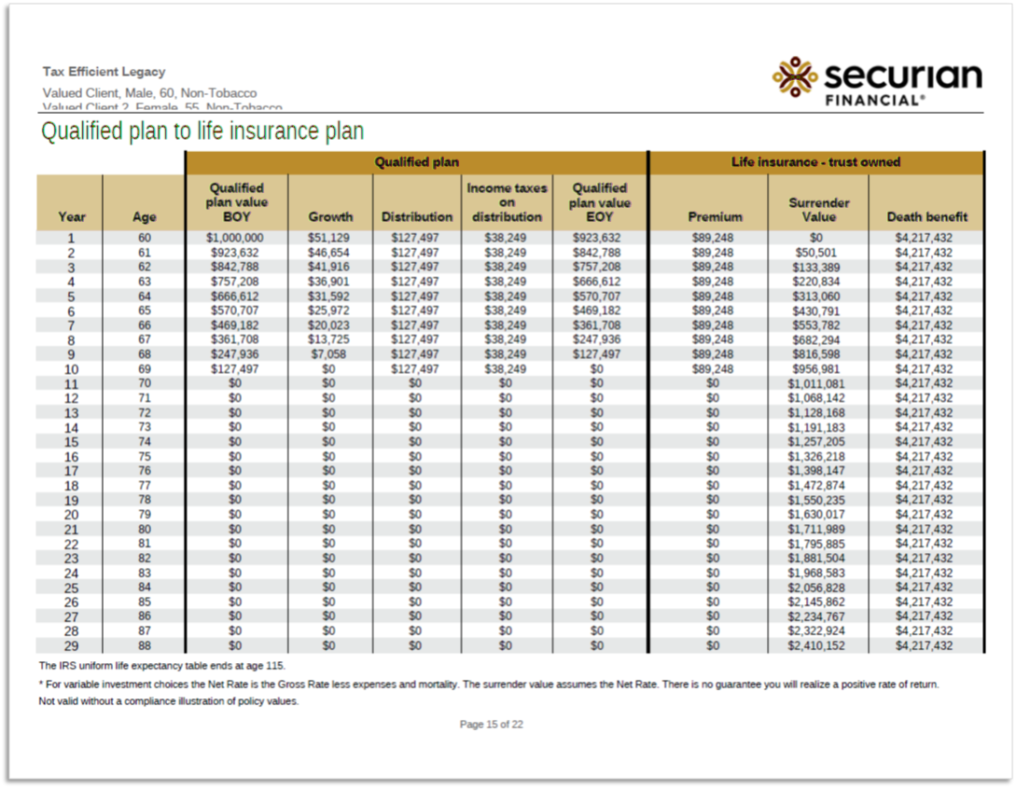
This is a hypothetical example for illustrative purposes only.
Notes:
Then beginning on page [15] the report demonstrates the funding of the life insurance policy.

Slide 20
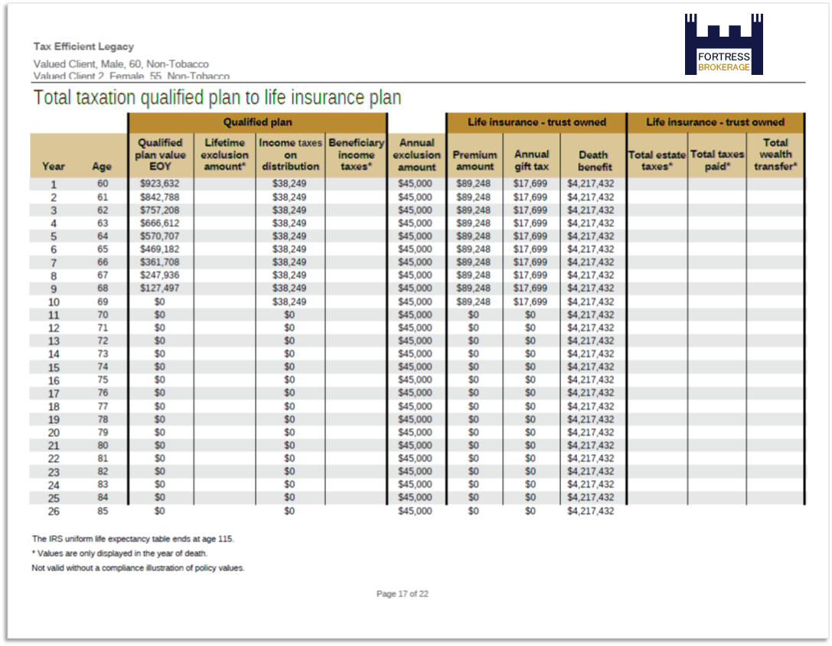
This is a hypothetical example for illustrative purposes only.
Notes:
And here we have the total taxation of the qualified plan to life insurance strategy.

Slide 21
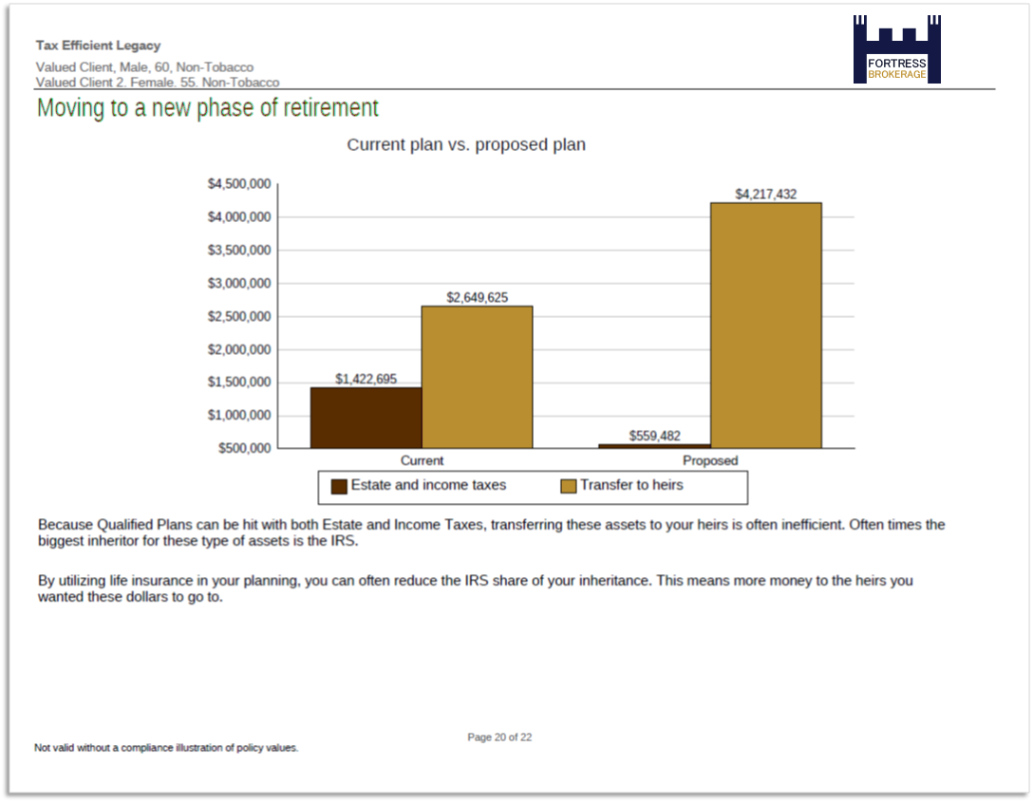
This is a hypothetical example for illustrative purposes only.
Notes:
And finally on page [21], we have a graphic depiction of the estate and income taxes and the transfer to heirs side-by-side between the client’s current situation and the proposed strategy.

Slide 22
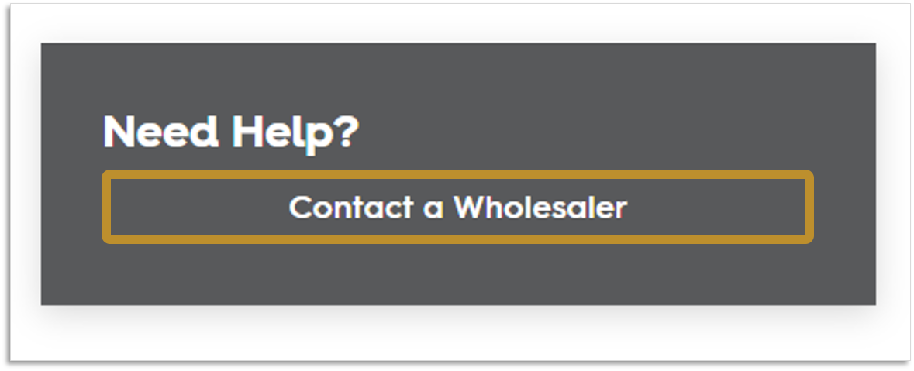
We’re here to help
Notes:
Remember, if you have trouble running these illustrations, need help with them or simply need someone to run one for you that’s what we’re here for. Just go ahead and click that button you see in our illustration system…

Slide 23
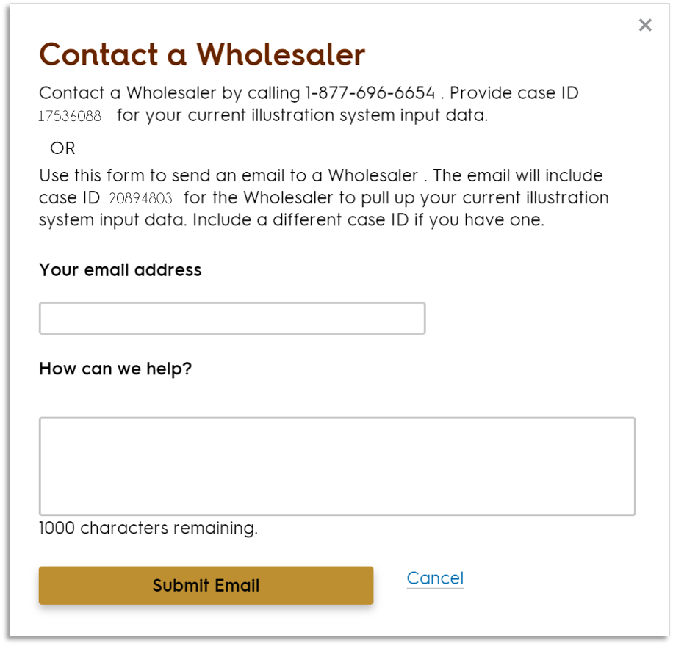
678-322-3040.
17536088
17536088
Notes:
… and this interface pops up. You can give us a call or send in a request and the case you’re working on will include the case ID.

Slide 24
Questions?
www.fortressbrokerage.com
6190 Powers Ferry Road, Suite 505 Atlanta, GA 30339
©2022 All Rights Reserved Fortress Brokerage Solutions.
Notes:
Let’s open it up for questions…
<take questions>
If nobody has any further questions, I have a bunch of disclosures to show you.

